Slide 1
CU Premed
MCAT EvenT
General MCAT overview and Information

Slide 2

What is the McAT?
https://students-residents.aamc.org/choosing-medical-career/what-you-need-know-about-mcat-exam

Slide 3
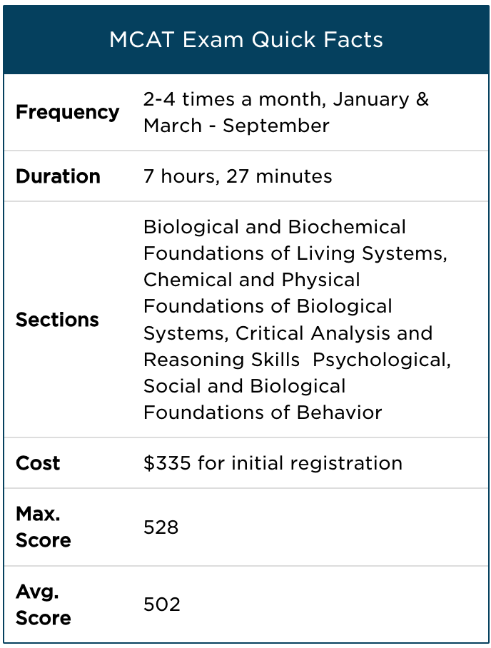
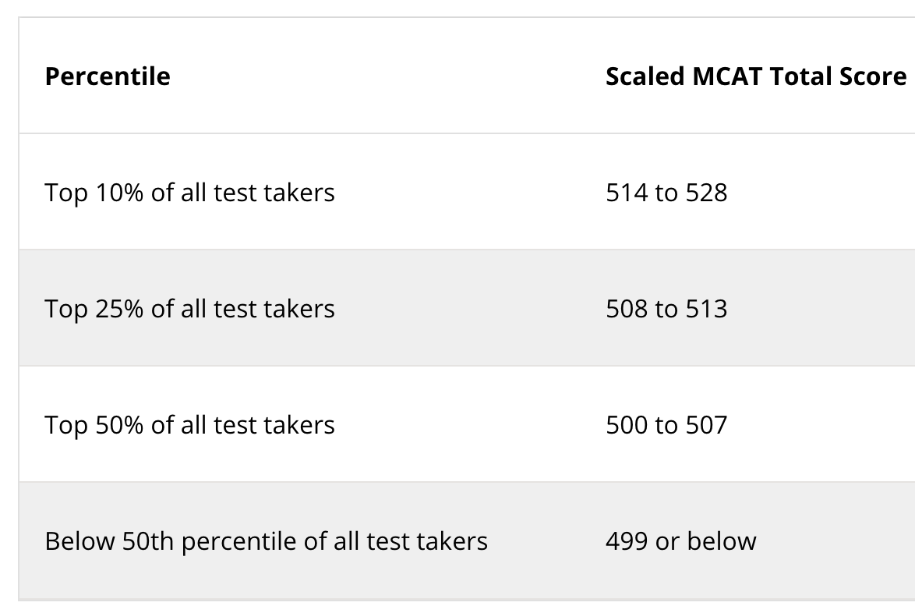
How is it scored?
Each individual section on the exam is scored using a 118 to 132 range, with a median score of 125. You'll receive a score for each section, plus an overall score. Total scores will be centered at 500, with ranges from 472 to 528.
(USD)
https://www.kaptest.com/mcat/what-is-the-mcat

Slide 4
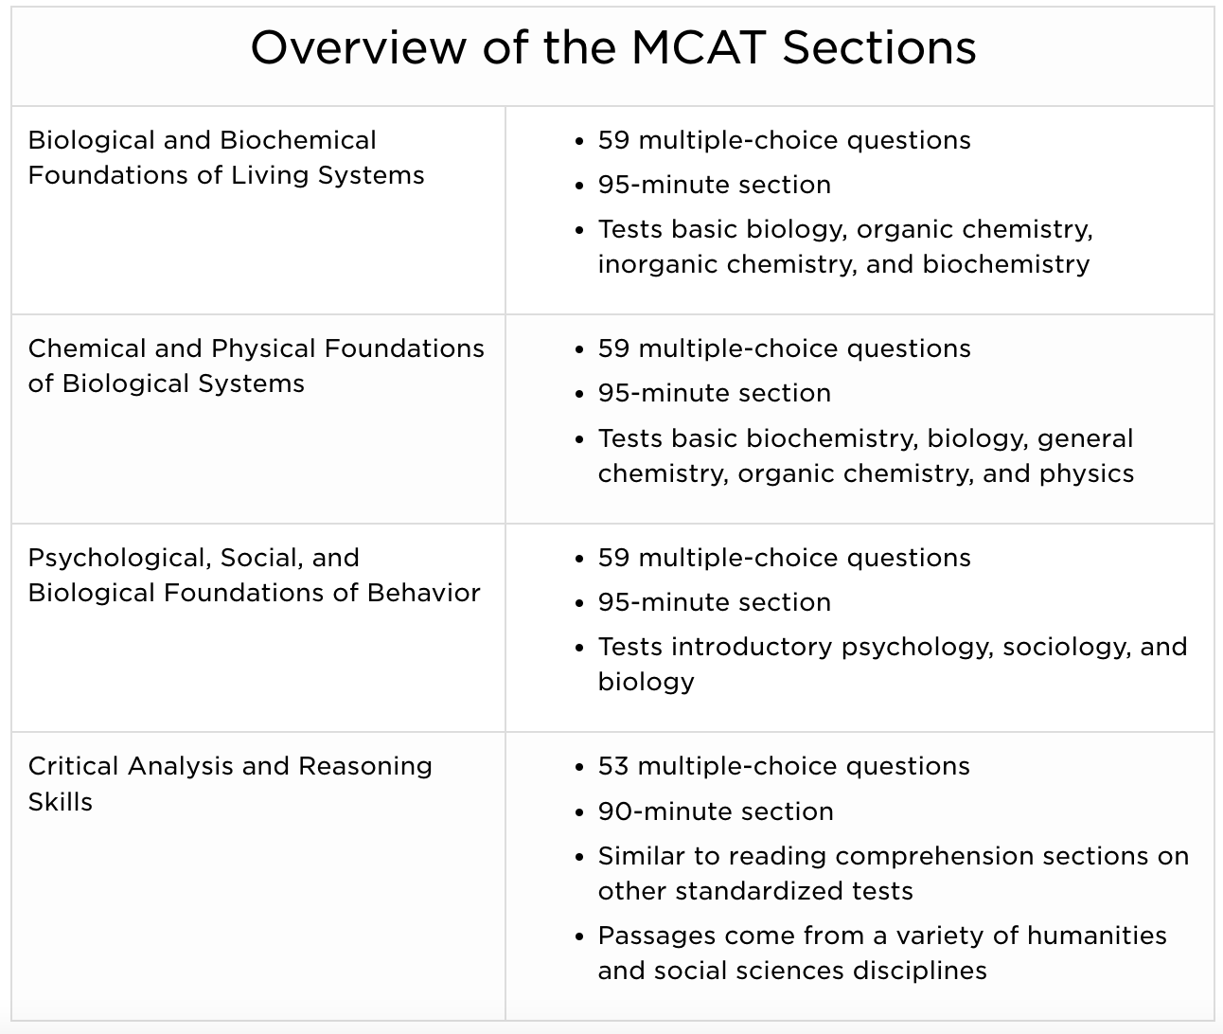
When to take it?
In many cases, examinees take their exam in the calendar year that precedes the year you plan to enter medical school. Before choosing an exam date, you’ll want to consider the likelihood that you’ll need to retake the exam and how well you understand the content. For example, if you plan to take a summer course that may help you on the MCAT exam, such as a science class, it may be best to take the exam later that summer.
Also, keep in mind that there are testing limits (three times in one calendar year, four times over two years, and seven times over the course of your lifetime), and medical schools will see all of your scores. Remember, you should take the exam only when you are prepared and ready.
https://students-residents.aamc.org/choosing-medical-career/what-you-need-know-about-mcat-exam

Slide 5
CU Premed
MCAT EvenT
Example MCAT questions for Practice!

Slide 6
Psychology Questions

Slide 7
Question #1
A student is volunteering in a hospital with a stroke center. When asked what he believes is the prevalence of stroke among those greater than 65 years old, the student states that it is probably about 40% even though data analysis indicates that it is significantly lower. What accounts for this error?
A. Deductive reasoning
B. Representativeness heuristic
C. Base rate fallacy
D. Confirmation bias

Slide 8
Answer #1
The correct answer is: C
The base rate fallacy occurs when prototypical or stereotypical factors are used for analysis rather than actual data. Because the student is volunteering in a hospital with a stroke center, he sees more patients who have experienced a stroke than would be expected in a hospital without a stroke center. Thus, this experience changes his perception and results in base rate fallacy. Deductive reasoning, choice (A), refers to drawing conclusions by integrating different pieces of evidence. The representativeness heuristic, choice (B), involves categorization and classification based on how well an individual example fits its category. Confirmation bias, choice (D), occurs when a person only seeks information that reinforces his or her opinions.

Slide 9
Question #1
According to Erik Erikson, the existential question that makes middle age so challenging is:
A: Who am I in relation to others?
B: Am I able to love?
C: Will I make my life count?
D: Did I live my life the way I wanted?

Slide 10
Answer #2
Correct Answer: C) Will I make my life count?
In middle adulthood, individuals face Erik Erikson's stage of "Generativity versus Stagnation," where the existential question is, "Will I make my life count?" This phase prompts reflection on one's contributions to society and the next generation.
Success in this stage involves nurturing others and leaving a positive legacy, leading to fulfillment and purpose. Conversely, feelings of stagnation arise when individuals feel disconnected and unproductive, resulting in a sense of emptiness and regret.
Therefore, this existential question captures the challenge of middle age, as individuals assess their impact on the world and their sense of fulfillment.

Slide 11
Question #3
Psychological, social, and biological foundations of behaviour:
According to Jean Piaget's theory of cognitive development, which stage is characterized by the development of conservation and reversibility?
A) Sensorimotor stage
B) Preoperational stage
C) Concrete operational stage
D) Formal operational stage

Slide 12
Answer #3
Correct answer: C) Concrete operational stage
In Piaget's theory, the concrete operational stage occurs between ages 7 and 11 and is characterized by the development of conservation, reversibility, and logical thinking about concrete events. Children in this stage can understand conservation principles, such as the idea that quantity remains the same even when appearance changes.

Slide 13
Chemistry Questions

Slide 14
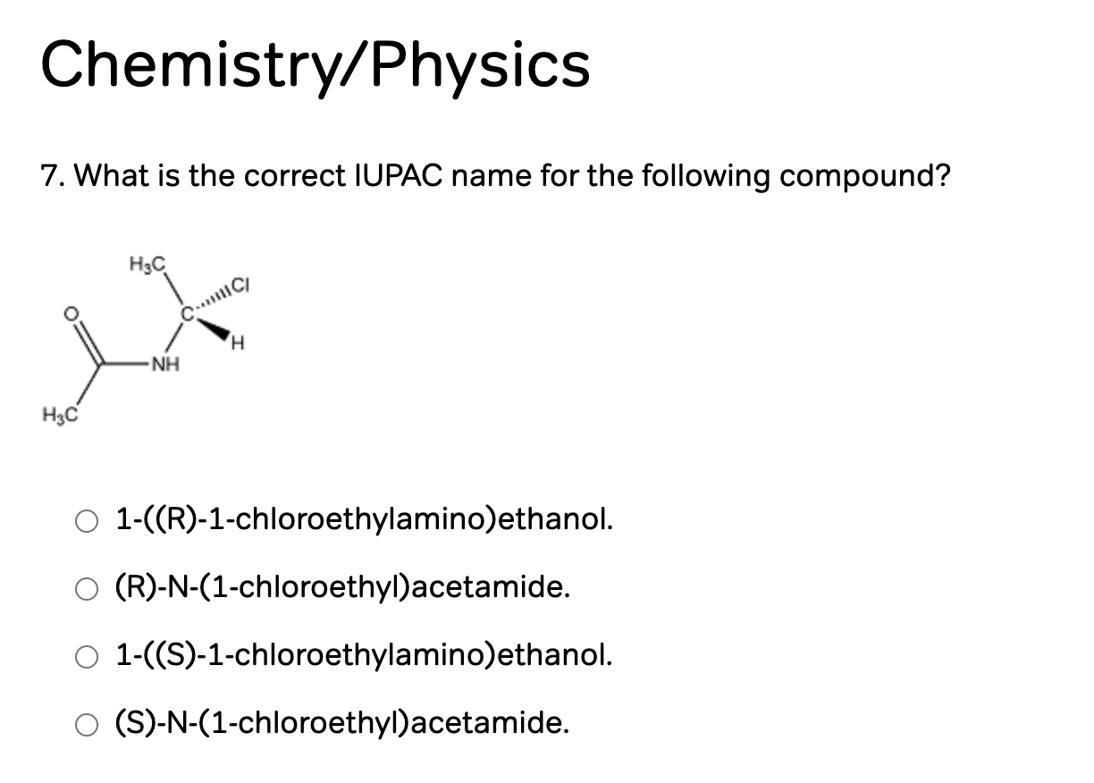

Slide 15

Answer #1:
This answer choice is correct. When you take the actual MCAT, nomenclature questions present a rare opportunity to use "strategy". Unlike your organic chemistry classes, where you were required to recall the name of a compound, here all you are being asked to do is recognize the correct answer from a group of four.
This question should be approached by first deciding whether it is (S) or (R). If you orient the lowest priority substituent (i.e. the hydrogen) of the chiral carbon so that it is facing away from you, you get the following picture:
The counterclockwise arrow moving from priority 1 → 2 → 3 is counterclockwise, so this molecule is (S).
The last step is to simply ask yourself if this molecule is a substituted ethanol or an acetamide. There are no hydroxyl groups so this must be an acetamide.

Slide 16
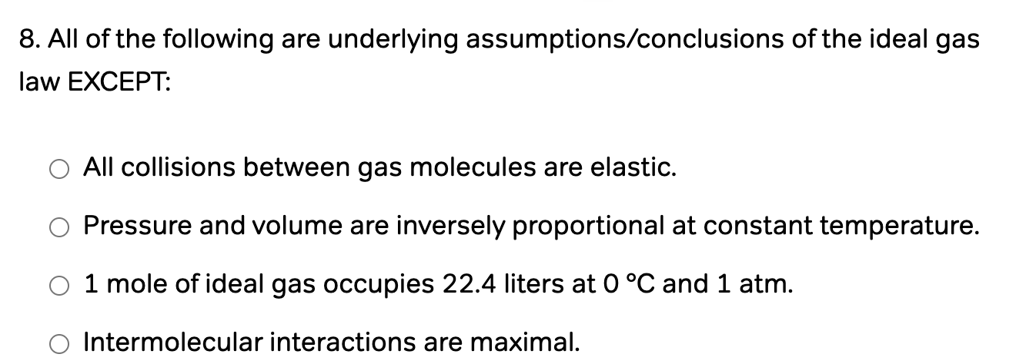
Question #2

Slide 17
Answer #2
For the MCAT, you should memorize the following assumptions that underlie the ideal gas law:
The volume of the gas molecules is negligible.
All collisions (molecule to molecule and molecule to container) are perfectly elastic.
There are no intermolecular interactions.
The temperature is proportional to the average kinetic energy of the gas molecules.
. From these assumptions you can deduce PV = nRT.

Slide 18
Question #3:
Chemical and physical foundations of biological systems:
Which of the following best describes the relationship between the Michaelis-Menten constant (Km) and enzyme-substrate binding affinity?
A) A low Km value indicates high enzyme-substrate binding affinity.
B) A high Km value indicates high enzyme-substrate binding affinity.
C) A low Km value indicates low enzyme-substrate binding affinity.
D) Km is unrelated to enzyme-substrate binding affinity.

Slide 19
Answer #3
Correct answer: A) A low Km value indicates high enzyme-substrate binding affinity.
Explanation: The Michaelis-Menten constant (Km) is a measure of an enzyme's affinity for its substrate. A lower Km value indicates that the enzyme has a higher affinity for its substrate, meaning it can achieve half-maximal velocity at lower substrate concentrations.

Slide 20
Biology and BIOCHEMISTRY Questions

Slide 21
Question #1
Which of the following is the correct sequence of the development of a mature sperm cell?
A. Spermatid → spermatocyte → spermatogonium → 2° spermatocyte → spermatozoan
B. Spermatogonium → 1° spermatocyte → 2° spermatocyte → spermatid → spermatozoan
C. Spermatozoan → 1° spermatocyte → 2° spermatocyte → spermatogonium → spermatid
D. Spermatogonium → 1° spermatocyte → 2° spermatocyte → spermatozoan → spermatid

Slide 22
Answer #1
The correct answer is (B).
Diploid cells called spermatogonia differentiate into primary spermatocytes, which undergo the first meiotic division to yield two haploid secondary spermatocytes. These undergo a second meiotic division to become immature spermatids. The spermatids then undergo a series of changes leading to the production of mature sperm, or spermatozoa.

Slide 23
Question 2:
Which of the following is likely to be found in maternal blood during pregnancy?
A. Immunoglobulins produced by the fetus
B. Fetal hemoglobin released from fetal red blood cells
C. Progesterone produced by placental cells
D. Carbon dioxide exhaled from fetal lungs

Slide 24
Answer #2
The correct answer is (C).
During pregnancy, the placenta produces estrogen and progesterone to maintain the endometrium. These hormones are necessary for proper gestation of the fetus and should be measurable in maternal blood because they act on maternal organs. Prior to birth, the fetus is immunologically naïve and does not yet produce immunoglobulins, eliminating choice (A). It is worth noting, though, that maternal immunoglobulins cross the placenta to enter fetal blood. Fetal hemoglobin is a large protein and, thus, cannot easily cross the placenta. Further, red blood cells are much too large to cross the barrier themselves, eliminating choice (B). Carbon dioxide from fetal metabolism can be found in maternal blood, but the lungs are nonfunctional prior to birth as the fetus is suspended in amniotic fluid. Carbon dioxide is transferred across the placenta directly from the fetal bloodstream, eliminating choice (D).

Slide 25
Question #3
In Chemiosmosis, hydrogen ions (protons) release their energy to produce ATP as they pass across the inner mitochondrial membrane. This process involves the use of:
A: ATP synthase
B: ATP dehydrogenase
C: ATP decarboxylase
D: Electron carriers

Slide 26
Answer #3
Correct Answer: A) ATP synthase
ATP synthase is an enzyme, a molecular motor, an ion pump, designed to synthesize ATP to ADP.

Slide 27
Physics QUESTION

Slide 28
Question #1
A student drops two balls of different masses from the same height. Ball A has a mass of 0.1 kg, while Ball B has a mass of 0.5 kg. Which of the following statements is true regarding their acceleration during free fall?
A) Ball A will accelerate faster than Ball B.
B) Ball B will accelerate faster than Ball A.
C) Both balls will accelerate at the same rate.
D) It is impossible to determine without knowing the shape of the balls.

Slide 29
Answer #1
Correct answer: C) Both balls will accelerate at the same rate.
According to the principles of gravitational acceleration, all objects near the surface of the Earth experience the same acceleration due to gravity, regardless of their mass. This acceleration is approximately 9.8 m/s2, denoted by the symbol "g."
Therefore, both balls, regardless of their masses, will accelerate towards the ground at the same rate under the influence of gravity.
This concept is famously illustrated by Galileo's experiment at the Leaning Tower of Pisa, where he showed that objects of different masses fall at the same rate when air resistance is negligible. Hence, the correct answer is C) Both balls will accelerate at the same rate.

Slide 30
Question #2
When a solid object is submerged in a fluid, which of the following statements accurately describes the relationship between the object's volume, weight, and the buoyant force acting on it?
A) The buoyant force is equal to the weight of the fluid displaced by the object, which is equal to the object's volume multiplied by the density of the fluid.
B) The buoyant force is equal to the weight of the object, which is equal to the object's volume multiplied by the density of the fluid.
C) The buoyant force is equal to the weight of the object, which is equal to the object's volume multiplied by the density of the object.
D) The buoyant force is equal to the weight of the fluid displaced by the object, which is equal to the object's volume multiplied by the density of the object.

Slide 31
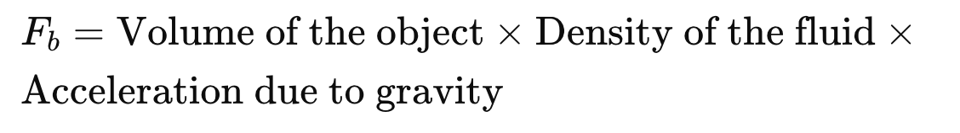
Answer #2
Correct answer: A) The buoyant force is equal to the weight of the fluid displaced by the object, which is equal to the object's volume multiplied by the density of the fluid.
Explanation: According to Archimedes' principle, when an object is submerged in a fluid, it experiences an upward buoyant force equal to the weight of the fluid it displaces. This buoyant force is independent of the object's weight and depends only on the volume of the object and the density of the fluid. Mathematically, the buoyant force (F_b) can be expressed as:
So, the correct answer is A) The buoyant force is equal to the weight of the fluid displaced by the object, which is equal to the object's volume multiplied by the density of the fluid.

Slide 32
CARS QUESTION
(Critical Analysis and Reasoning Skills)

Slide 33
Passage:
The Wealth of Nations (1776) popularized “the invisible hand,” the idea that an individual who intends only personal gain is, as it were, led by an invisible hand to promote the public interest. Adam Smith did not assert that this principle was invariably true, but it contributed to a tendency of thought that has since remained dominant, preventing action based on rational analysis: the assumption that decisions reached individually will collectively be the best decisions for society as a whole. If this assumption is correct, it justifies the continuance of the U.S. policy of laissez-faire in many issues affecting business, the environment, and the family. If it is not correct, U.S. citizens need to re-examine their individual freedoms to see which are defensible.
The rebuttal to the invisible hand theory could be called “the tragedy of the commons.” Picture a pasture open to all. It can be expected that each herder will try to keep as many cattle as possible on this commons. Such an arrangement may work reasonably well for centuries because tribal wars, poaching, and disease keep the numbers of both human and beast far below the carrying capacity of the land. Finally, however, comes the day of reckoning–that is, the day on which the long-desired goal of social stability becomes a reality. At this point, the inherent logic of the commons remorselessly generates tragedy.
As a rational being, each herder seeks to maximize personal gain. More or less consciously, the individual asks, “What is the utility to me of adding one more animal to my herd?” Since the herder would receive all the proceeds from the sale of the additional animal, the positive component of this utility is nearly +1. The negative component is a function of the overgrazing caused by an additional animal. Since the effects of overgrazing are shared by all the herders, the negative utility for any particular decision-maker is some fraction of -1.
Adding the component utilities, the rational herder concludes that the only sensible course is to add another animal to his or her herd—and another, and another. . . . This conclusion is reached by every rational herder who shares the commons. All are locked into a system that compels each to increase his or her gain without limit in a world that is limited. Ruin is the destination toward which all rush, each pursuing the right to use a public resource. The problem is that a commons, if justifiable at all, is justifiable only under conditions of low population density. As the human population has increased, the commons concept has had to be abandoned in one aspect after another.
The social arrangements that would produce responsibility in this scenario create coercion. The only kind of coercion I recommend is mutual coercion, agreed to by a majority of those affected. Compulsory taxes are acceptable because a system of voluntary contributions would favor the conscienceless. A society institutes and (grumblingly) supports taxes and other coercive devices to escape the horror of the commons.
Every new enclosure of the commons involves the infringement of somebody’s personal freedom. But what does “freedom” mean? Those subject to the logic of the commons are free only to bring on universal ruin. Once they acknowledge the logic of mutual coercion, they become free to pursue other goals. We must now recognize the necessity of abandoning the commons assumption in our reproduction. Failure to do so will bring ruin on us all.

Slide 34
Question #1
1. According to the passage, the decisive factor in determining whether someone’s actions should be subject to coercion is whether the actions:
A) are determined solely by self-interest.
B) affect collectively held resources.
C) degrade the natural environment.
D) are commonly considered immoral.

Slide 35
Answer
Correct Answer is B) affect collectively held resources.
Rationale: The passage argument is not that all actions determined by self-interest should be regulated—only those actions in which the gain of one represents a loss to all and voluntary restraint is unlikely. Thus, option A is incorrect. Implicitly, coercion is needed to “produce responsibility” in circumstances to which the parable of the commons applies—i.e., resources are held collectively, so that self-interest “compels each to increase his or her gain without limit in a world that is limited.” Thus, option B is correct. The author implicitly favors coercion rather than “the U.S. policy of laissez-faire in many issues affecting business, the environment, and the family.” Therefore, degradation of the natural environment, although among the issues affecting “the public interest,” would not be a relevant criterion for every decision about the need for coercion. Thus, option C is incorrect. The passage questions the “assumption that decisions reached individually will collectively be the best decisions for society as a whole.” This is a question of economic philosophy, not of personal morality. Thus, option D is incorrect.

Slide 36
Question #2
2. The passage argument suggests that national parks might benefit from:
I. the restriction of recreational use by means of fees.
II. the selling of the facilities to private investors.
III. the opening of additional facilities to the public.
A) I only
B) III only
C) I and II only
D) II and III only

Slide 37
Answer #2
Correct Answer is A) I only
Rationale: Since everyone has “the right to use a public resource,” pressure on the terrain and ecosystems of national parks increases as population increases. Therefore, these lands would benefit by the imposition of fees that reduced their use by the public (option I). Thus, option A is correct. The opening of additional parklands to the public (option III) might delay “the day of reckoning,” but only by exposing even more resources to the tragedy of the commons. According to the passage, the solution to the problem of overuse is not to enlarge the commons but to abandon the commons concept. If resources to which the commons analogy currently applied became concessions for private investors (option II), charges in their use by the public might result. However, since the passage provides no analysis of the decision-making process involved in the wish of private owners “to maximize personal gain,” it does not justify a conclusion about the effect on parklands of privatization.

